Slide 1
Lecture 18 Wrap-up
Hamed Hasheminia

Slide 2
Agenda
What model should I use?
Summary of all the models we learned in this class
Few models that you can easily learn on your own

Slide 3
What model should I use?
Ask yourself the following questions:
1. Do I have an output or not?
If yes, you need to use a supervised learning technique, otherwise, you must use an unsupervised technique.
In this class we mainly focused on supervised learning techniques. (An exception was Principle Component Method)
2. (Assuming you have a supervised learning problem) ask yourself if your output is a quantitative variable or qualitative. If it is quantitative you MUST use one of the regression methods, otherwise you MUST use a classification algorithm.

Slide 4
Here is the list of all Regression models we learned in this class
Linear Regression Lines
Lasso & Ridge (on regression lines)
KNN – Regression
Decision Tree – Regression
Bagging, random forest
Boosting
ARIMA, ARMA, MA, AR (These can only be applied on time series data)

Slide 5
Here is the list of all Classification models we learned in this class
Logistic Regression
KNN – Classification
Decision Trees (Classification)
Bagging, Random Forest
Boosting
Naïve Bayes
GuassianNB for quantitative inputs
BernoulliNB and MultinomialNB for categorical inputs

Slide 6
How do we decide which model(s) to use?
3. ask yourself if your goal is interpretation or prediction
Interpretative models for regression models are:
Linear Regression Models Specifically Lasso
Simple regression decision trees
Predictive regression models are:
Random Forest and Boosting
KNN (specifically if our feature space is less than 5)
ARIMA, ARMA, MA, AR (These can only be applied on time series data). Low order of ARIMA, ARMA, MA, and AR models are relatively interpretable. Higher order are not that interpretable. This is mainly why they are usually only used for prediction.

Slide 7
How do we decide which model(s) to use?
Interpretative models for classification problems are:
Logistic regression (for dichotomous outputs)
Classification Decision Trees
Predictive classification models are:
Random Forest
Boosting
KNN (Specifically if our feature space is less than 5)
Naïve Bayes (this is very strong if we have text data)

Slide 8
Advantages and Limitations of Each of the models we learned about
Linear Regression Models. (advantages)
Very interpretable
Easy to compute
You can run it on Sparse data
No need to standardize your data
Disadvantages
Since they assume linear association among variables, it is not that predictable
It assumes normally distributed error terms
Outliers can easily affect coefficients

Slide 9
Lasso and Ridge Regression
Ridge Regression
Easy to compute
Coefficients usually only converge to zero but do not become zero
We shall standardize our data
Lasso Regression
Harder to compute – since absolute values do not have first order derivative at 1 point
Irrelevant coefficients swiftly become zero
We shall standardize our data

Slide 10
Regression KNN algorithms
Advantages
Very easy to compute
Intuitive
Easily Capture non-linearity
Disadvantages
Results are not interpretable
If you have sparse data and feature space is more than 4, this algorithm cannot be used.
We shall standardize our data

Slide 11
Simple Decision Trees(regression and Classification)
Advantages :
Extremely interpretable
Very easy to train
No need to scale your data
Cons:
Not that predictable

Slide 12
Decision Trees Random Forest and Bagging
Advantages
Relatively easy to train
Good predictors
No need to scale your data
Disadvantages
Not suitable for interpretation

Slide 13
Decision Trees - Boosting
Advantages
Very good predictors
No need to scale data
Disadvantages
3 parameters needed to be Tuned – very time-consuming
Easy to overfit

Slide 14
Time series models ARIMA, ARMA, MA, AR
Advantages
AR – good for smoothing patterns
MA – good for tackling shocks in the system
ARMA – Combines AR and MA – relatively time consuming to train
ARIMA – Combines AR and MA, also takes care of linear trends in the model
Disadvantages
Only applicable to time-series data
Not that interpretable (Exception is when you have small p and q)
You shall clean and prepare data before applying these models.

Slide 15
Naïve Bayes
Advantages
Extremely Fast
Great for Text Mining
Disadvantages
Strong Assumption of independency of inputs
Terrible for interpretation
Never rely on probability predictions

Slide 16
Can we combine few models?
Yes! We are going to combine few models in our today’s Lab session!
In python, for classification problems we can use:
VotingClassifier()
Can we also combine quantitative methods?
The answer is yes again. Generalized Additive Models – GAMs – are developed to deal with this.

Slide 17
What else did we learn in this class?
We discussed how do deal with missing values.
We learned wrong ways of dealing with it and correct ways.
Here are few wrong approaches:
Dropping all missing values if missing values are not random.
Using Mean Imputation
Using Median Imputation
Using Regression Lines
Here is a slightly better way of dealing with missing values
Regression Lines with error term – this was the best we could do in Python
Correct way of dealing with missing values
Multiple Imputation

Slide 18
Validation vs Cross-Validation
Validation: Divide your data to test and train. Train with training Data and Test it with test data. If you have a large dataset, Validation technique is always preferred.
Cross-Validation: Divides data into few groups. Then train based on all groups but one, and then test it on the one that is left outside. It repeats it on all groups. This way, you are not wasting any Data. Use it when you have a small dataset.
Can we combine Validation and Cross-Validation?
Yes, of course! You can tune based on Cross-Validation and then test it on completely unseen data – test set.

Slide 19
Natural Language Processing
We learned about stop words
Bag-of-words (Great of smaller texts)
TFDIF (Great for long texts)
Lemmatization and stemming
We used CountVectorizer() and TfidfVectorizer() in lab. We also used pipeline library.
Lemmatization
shouted → shout
best → good
better → good
good → good
Stemming
badly → bad
computing → comput
computed → comput

Slide 20
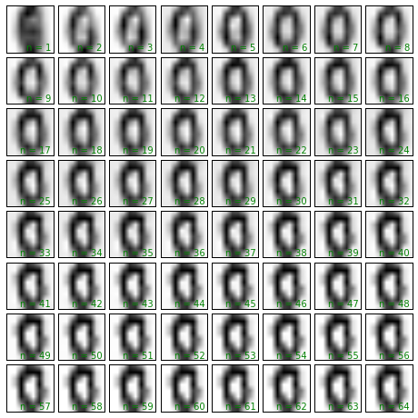
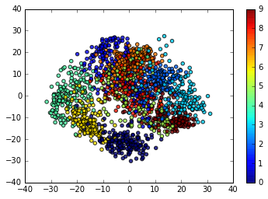
Principal Component Method

Slide 21
What is left?
A lot! But there are few things that I am confident you can learn on your own!
For Unsupervised Learning Techniques: Easy, Medium, Hard
K-Means Clustering (an unsupervised technique to cluster your data.
Hierarchical Trees (Another unsupervised technique to cluster data)
Principal Curves and and Surfaces
Kernel Principal Components
Self-Organizing Maps (NN)

Slide 22
Few Supervised Learning Techniques left
For Supervised Learning Techniques: Easy, Medium, Hard
Back propagation/feed forward neural Networks
Splines
Support Vector Machines
Ordinal Logistic Regression Models
Generalized Additive Models
Local Regression Models
Directed Graphical Models (Bayes nets)
Undirected Graphical Models
Linear and Quadratic Discriminant Analysis (LDA, QDA)
Fuzzy rule-based systems
Markov and Hidden Markov Models
Deep Learning (Deep directed networks, Deep Boltzmann Machines, Deep Neural Networks)

Slide 23
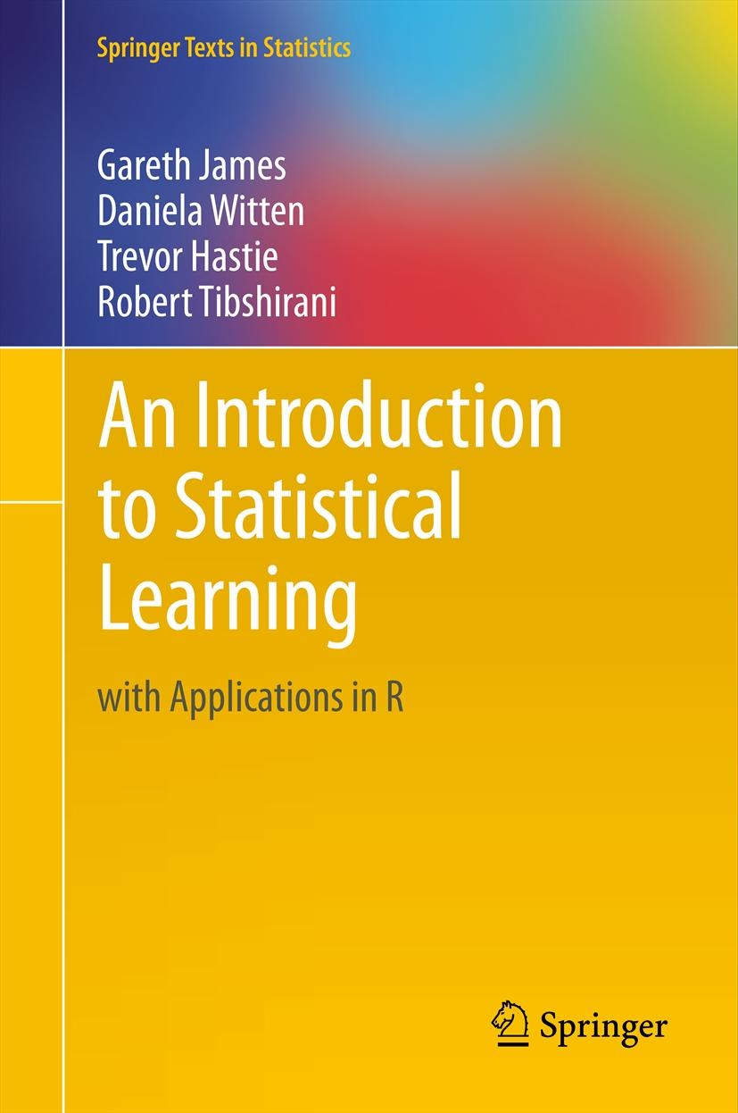
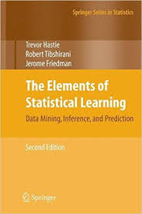
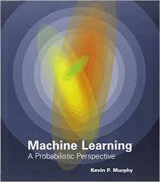
If you are interested to learn more, read these three books Sequentially
1. Statistical Learning with applications in Rhttp://www-bcf.usc.edu/~gareth/ISL/ISLR%20Sixth%20Printing.pdf
2. The Elements of Statistical Learning – Data Mining
Inference, and Prediction
https://web.stanford.edu/~hastie/local.ftp/Springer/OLD/ESLII_print4.pdf
3. Machine Learning – A probabilistic Perspective
(By Kevin Murphy)

